Slide 1
Linux Security
LINUX SECURITY

Slide 2


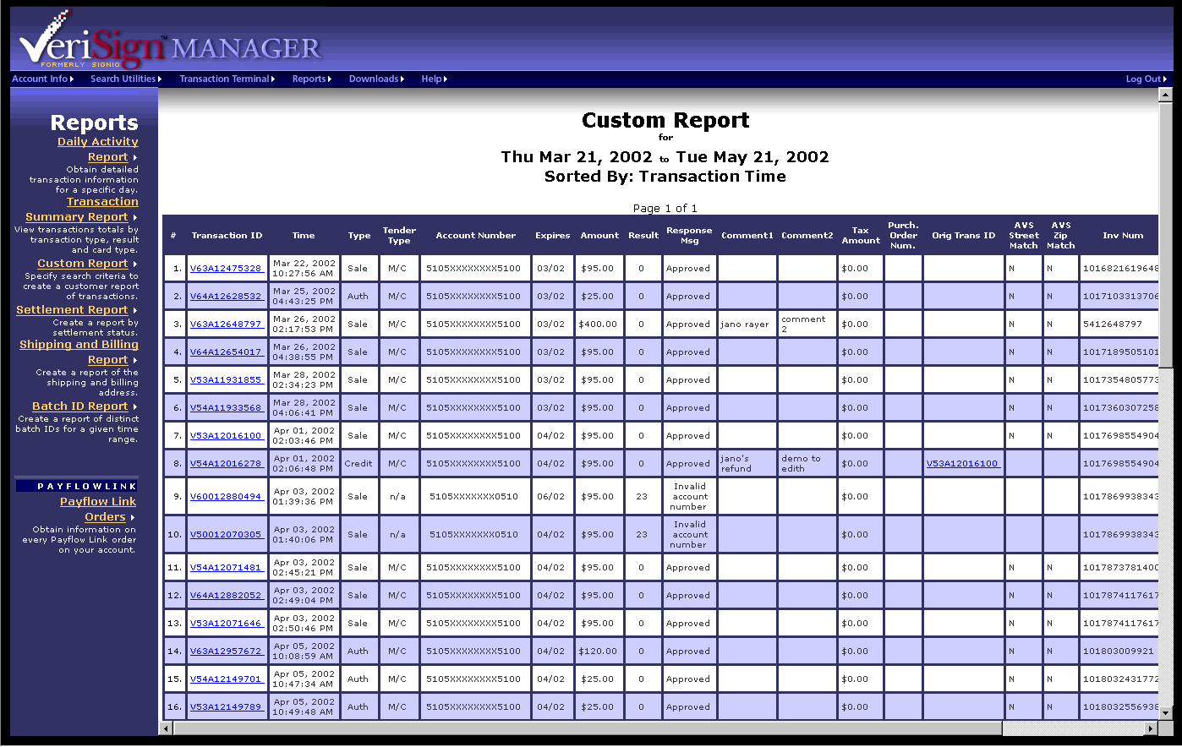
Firewall
Linux Security
Internet
Application
Web Server
Firewall
Database

Slide 3
LINUX Firewall
Linux Security
Use GUI (Applications ->System Settings-> Security Level) to activate the firewall
Allow standard services and any specific port based application
All other services and ports are blocked

Slide 4
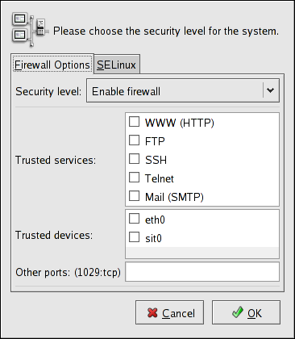
LINUX Firewall
Linux Security

Slide 5
SELinux
Linux Security
Malicious or broken software can have root-level access to the entire system by running as a root process.
SELinux (Security Enhanced Linux) provides enhanced security.
Through SELinux policies, a process can be granted just the permissions it needs to be functional, thus reducing the risk

Slide 6
SELinux
Linux Security
SELINUX can take one of these three values
enforcing - SELinux security policy is enforced.
permissive - SELinux prints warnings instead of enforcing.
disabled - SELinux is fully disabled.

Slide 7
SELinux Configuration
Linux Security
Use GUI (Applications ->System Settings-> Security Level) to activate SELinux
Enable/Disable SELinux
Allow standard features in various services (http,nis,nfs,dns etc.)
All other services and features are blocked

Slide 8
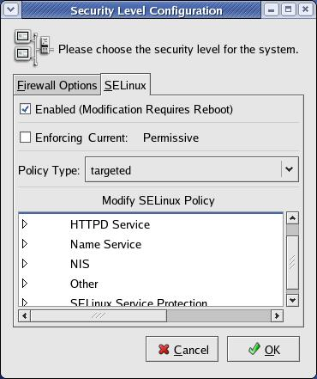
SELinux Configuration
Linux Security

